Slide 1
Hotel Bookings
Widoseno N. S. Atri

Slide 2
Outline
Objective
hotel_bookings data
Data Explanation
Data Exploration
Modelling

Slide 3
Objective
This project aims to distinguish whether a hotel booking is likely to be canceled or not
Certain steps can be carried out by the hotel towards the guest that is likely to cancel

Slide 4
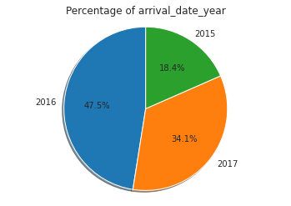
hotel_bookings data
Bookings of Hotels in Portugal
From July 2015 – August 2017
119390 rows
32 Columns/Features
Source:
  https://www.kaggle.com/jessemostipak/hotel-booking-demand
  https://www.sciencedirect.com/science/article/pii/S2352340918315191
Notes:
Accesed on February 13

Slide 5
Data Explanation
hotel Hotel (H1 = Resort Hotel or H2 = City Hotel)
is_canceled Value indicating if the booking was canceled (1) or not (0)
lead_time Number of days that elapsed between the entering date of the booking into the PMS and the arrival date
arrival_date_year Year of arrival date
arrival_date_month Month of arrival date
arrival_date_week_number Week number of year for arrival date
arrival_date_day_of_month Day of arrival date
stays_in_weekend_nights Number of weekend nights (Saturday or Sunday) the guest stayed or booked to stay at the hotel
stays_in_week_nights Number of week nights (Monday to Friday) the guest stayed or booked to stay at the hotel
adults Number of adults
children Number of children
babies Number of babies
meal Type of meal booked. Categories are presented in standard hospitality meal packages:
  Undefined/SC – no meal package;
  BB – Bed & Breakfast;
  HB – Half board (breakfast and one other meal – usually dinner);
  FB – Full board (breakfast, lunch and dinner)

Slide 6
Data Explanation
country Country of origin. Categories are represented in the ISO 3155–3:2013 format
market_segment Market segment designation. In categories, the term “TA” means “Travel Agents” and “TO” means “Tour Operators”
distribution_channel Booking distribution channel. The term “TA” means “Travel Agents” and “TO” means “Tour Operators”
is_repeated_guest Value indicating if the booking name was from a repeated guest (1) or not (0)
previous_cancellations Number of previous bookings that were cancelled by the customer prior to the current booking
previous_bookings_not_canceled Number of previous bookings not cancelled by the customer prior to the current booking
reserved_room_type Code of room type reserved. Code is presented instead of designation for anonymity reasons.
assigned_room_type Code for the type of room assigned to the booking. Sometimes the assigned room type differs from the reserved room type due to hotel operation reasons (e.g. overbooking) or by customer request. Code is presented instead of designation for anonymity reasons.
booking_changes Number of changes/amendments made to the booking from the moment the booking was entered on the PMS until the moment of check-in or cancellation

Slide 7
Data Explanation
deposit_type Indication on if the customer made a deposit to guarantee the booking. This variable can assume three categories:
  No Deposit – no deposit was made;
  Non Refund – a deposit was made in the value of the total stay cost;
  Refundable – a deposit was made with a value under the total cost of stay.
agent ID of the travel agency that made the booking
company ID of the company/entity that made the booking or responsible for paying the booking. ID is presented instead of designation for anonymity reasons.
days_in_waiting_list Number of days the booking was in the waiting list before it was confirmed to the customer
customer_type Type of booking, assuming one of four categories:
  Contract - when the booking has an allotment or other type of contract associated to it;
  Group – when the booking is associated to a group;
  Transient – when the booking is not part of a group or contract, and is not associated to other transient booking
  Transient-party – when the booking is transient, but is associated to at least other transient booking
adr Average Daily Rate as defined by dividing the sum of all lodging transactions by the total number of staying nights
required_car_parking_spaces Number of car parking spaces required by the customer
total_of_special_requests Number of special requests made by the customer (e.g. twin bed or high floor)

Slide 8
Data Explanation
reservation_status Reservation last status, assuming one of three categories:
  Canceled – booking was canceled by the customer;
  Check-Out – customer has checked in but already departed;
  No-Show – customer did not check-in and did inform the hotel of the reason why
reservation_status_date Date at which the last status was set. This variable can be used in conjunction with the ReservationStatus to understand when was the booking canceled or when did the customer checked-out of the hotel

Slide 9
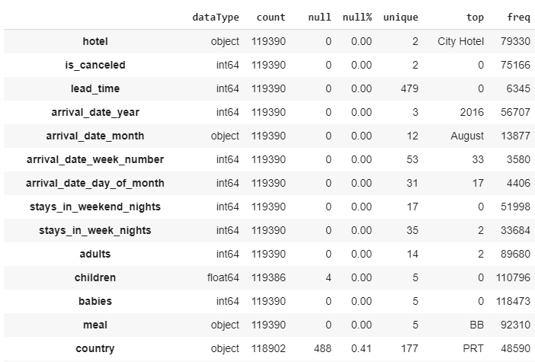

Slide 10
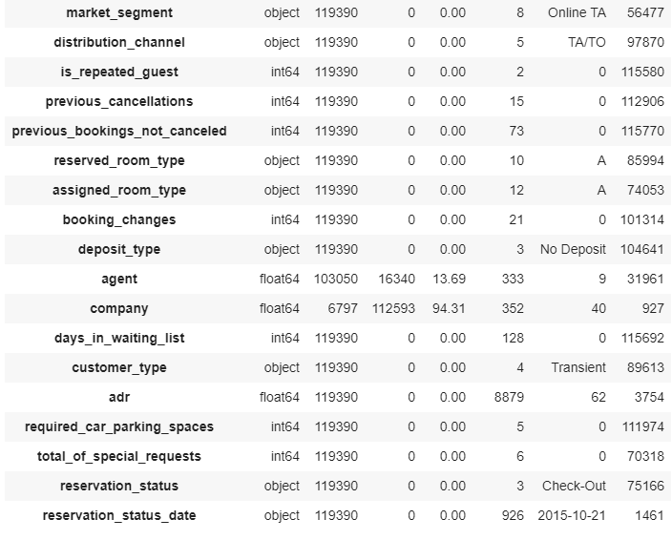

Slide 11
EDA

Slide 12
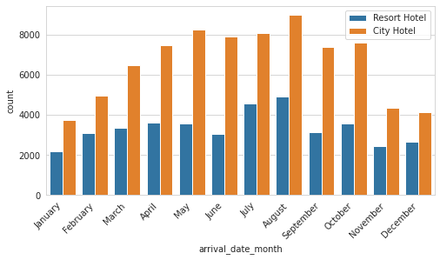

Slide 13
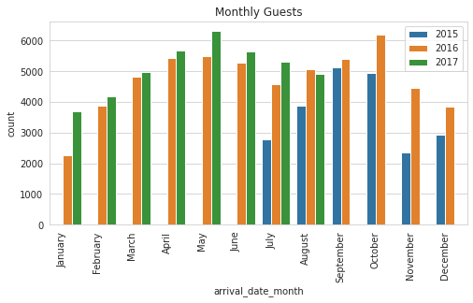

Slide 14
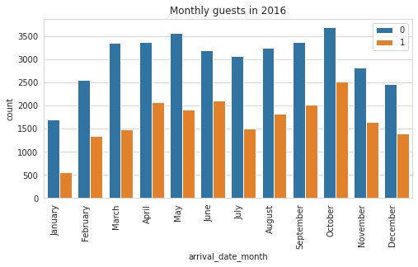

Slide 15
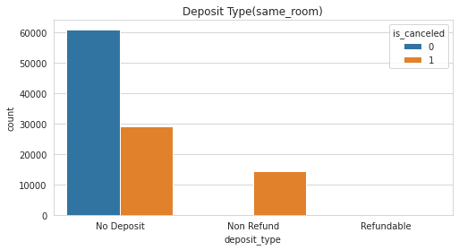
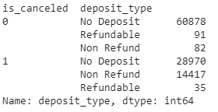

Slide 16
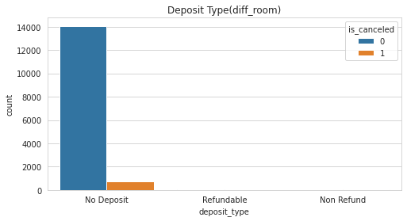
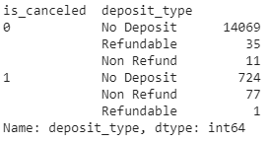

Slide 17
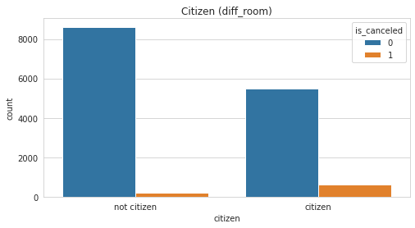
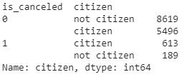

Slide 18
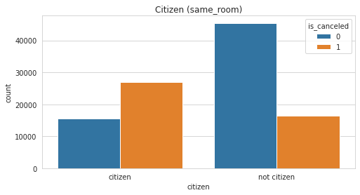
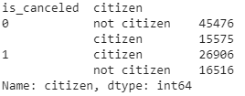

Slide 19
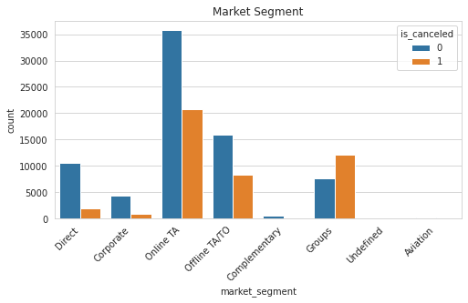
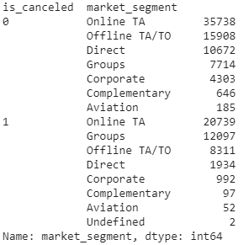

Slide 20
Machine Learning
Cleaning
Dummies
Smote
Fit
Predict
There are 66 Features in total
PCA
Split
Trying PCA, 37 Features only covers 80% of the data
To balance the cancelled and not cancelled
80-20 train-test split
5 different models used
Logistic Regression
Decision Tree C.
Random Forest C.
Gradient Boosting
XGBoost
Removing odd data
Feature engineering

Slide 21
Model Evaluation
Logistic Regression Accuracy = 0.77, 0.74 | Precision | Recall
Class 0 | Ori : 0.77 Sm : 0.74 | Ori : 0.91 Sm : 0.73
Class 1 | Ori : 0.78 Sm : 0.73 | Ori : 0.54 Sm : 0.75
Decision Tree C. Accuracy = 1.00, 1.00 | Precision | Recall
Class 0 | Ori : 1.00 Sm : 1.00 | Ori : 1.00 Sm : 1.00
Class 1 | Ori : 1.00 Sm : 1.00 | Ori : 0.99 Sm : 1.00
Random Forest C. Accuracy = 1.00, 1.00 | Precision | Recall
Class 0 | Ori : 1.00 Sm : 1.00 | Ori : 1.00 Sm : 1.00
Class 1 | Ori : 1.00 Sm : 1.00 | Ori : 0.99 Sm : 1.00
Gradient Boosting Accuracy = 0.76, 0.82 | Precision | Recall
Class 0 | Ori : 0.73 Sm : 0.82 | Ori : 1.00 Sm : 0.82
Class 1 | Ori : 1.00 Sm : 0.82 | Ori : 0.37 Sm : 0.82

Slide 22
XGBoost
Drop_NonCat Accuracy = 0.85, 0.87, 0.84 | Precision | Recall
Class 0 | Ori : 0.85 Sm : 0.85 OS : 0.88 | Ori : 0.92 Sm : 0.89 OS : 0.86
Class 1 | Ori : 0.84 Sm : 0.89 OS : 0.77 | Ori : 0.73 Sm : 0.85 OS : 0.81
Drop_Cat Accuracy = 0.85, 0.87, 0.84 | Precision | Recall
Class 0 | Ori : 0.85 Sm : 0.85 OS : 0.88 | Ori : 0.91 Sm : 0.89 OS : 0.85
Class 1 | Ori : 0.83 Sm : 0.88 OS : 0.77 | Ori : 0.73 Sm : 0.85 OS : 0.81
fillna_NonCat Accuracy = 0.86, 0.87, 0.85 | Precision | Recall
Class 0 | Ori : 0.86 Sm : 0.86 OS : 0.90 | Ori : 0.93 Sm : 0.89 OS : 0.85
Class 1 | Ori : 0.86 Sm :0. 89 OS : 0.77 | Ori : 0.75 Sm : 0.85 OS : 0.84
fillna_NonCat Accuracy = 0.86, 0.88, 0.85 | Precision | Recall
Class 0 | Ori : 0.86 Sm : 0.86 OS : 0.90 | Ori : 0.92 Sm : 0.90 OS : 0.85
Class 1 | Ori : 0.85 Sm : 0.89 OS : 0.77 | Ori : 0.75 Sm : 0.86 OS : 0.85

Slide 23
XGBoost Train-Test Comparison
Drop_NonCat Accuracy = 0.85, 0.87, 0.84 | Precision | Recall
Class 0 | Ori : 0.85 Sm : 0.85 OS : 0.88 | Ori : 0.92 Sm : 0.89 OS : 0.86
Class 1 | Ori : 0.84 Sm : 0.89 OS : 0.77 | Ori : 0.73 Sm : 0.85 OS : 0.81
Drop_NonCat Accuracy = 0.85, 0.87, 0.84 | Precision | Recall
Class 0 | Ori : 0.85 Sm : 0.86 OS : 0.89 | Ori : 0.92 Sm : 0.89 OS : 0.86
Class 1 | Ori : 0.84 Sm : 0.80 OS : 0.77 | Ori : 0.73 Sm : 0.76 OS : 0.81

Slide 24
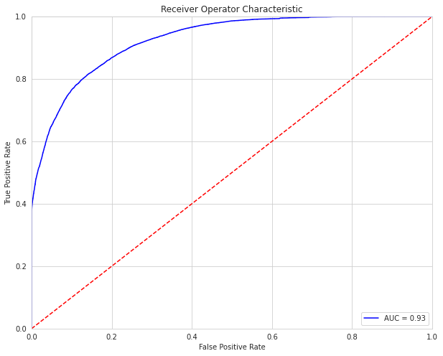

Slide 25
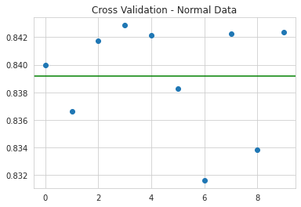

Slide 26
